Slide 1
Course Project
Operating Systems
Module 4 User and Group Management

Slide 2
Rubric
Activity | Requirement(s) | Points
Add users and groups in CLI | Answer three questions | 15
Test user and group settings | Take a screenshot | 15
Add users in GUI | Take a screenshot | 15
Remove users and groups | Take a screenshot | 15

Slide 3
Add users and groups in CLI
1. What does the –m option in the useradd command do?
Answer here: move the content of the user's home directory to the new location
2. What does the -3 option in the tail command do?
Answer here: provides the last 3 lines in a file
3. Which line of the /etc/group file lists members of the “students” group? Copy it here.
Answer here:Last line
References:
1. Manual in Linux
2.

Slide 4
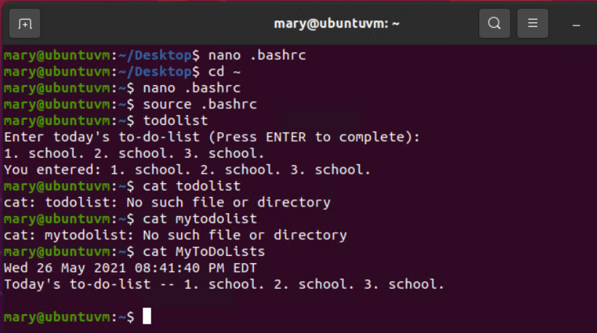
Test user and group settings
Take a screenshot of the output in Step 6.

Slide 5
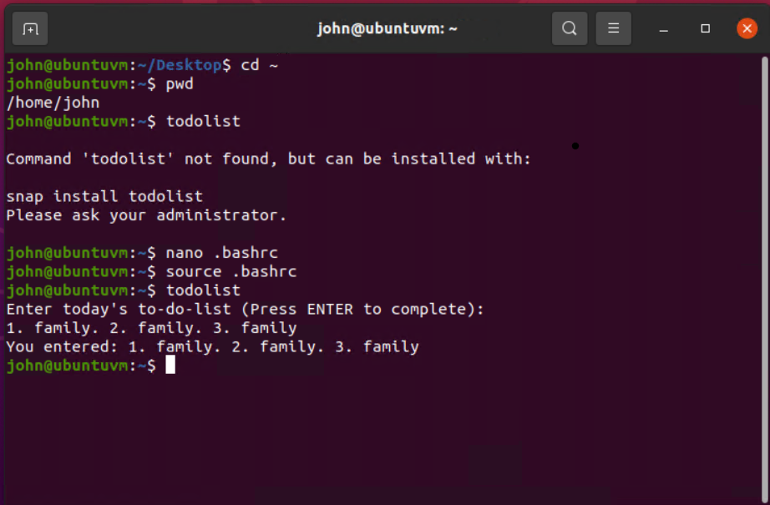
Add users in GUI
Take a screenshot of the output in Step 9.

Slide 6
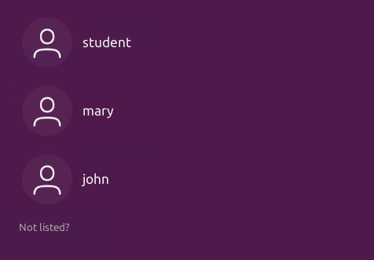
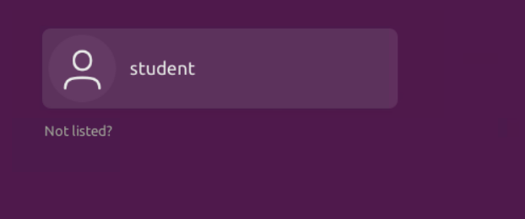

Remove users and groups
Take a screenshot of the log on page with three user accounts.
Take a screenshot of the log on page with only your user account (i.e., student).

